Slide 1


… presentation will start soon
Simplifying AI Complexity:
Unmasking the conspiracy
Gentle introduction to Generative AI for all to understand and empower
presented by:
Aleksandar Stoisavljević, Director of Engineering
Novi Sad
14. Novembar 2024.

Slide 2


Slide 3
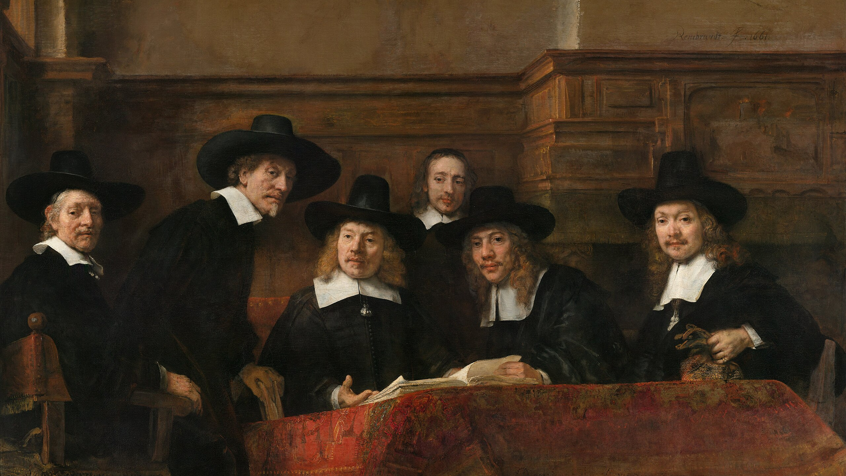

Slide 4



Aleksandar Stoisavljević
soft. architect & director of engineering @Jatheon
Accomplished individual with a strong background in Java (20+ yrs. in IT business). Goal oriented, analytical and sharp individual with a lot of energy. Strong will to spread inspiration among his co-workers. Coming from city of Novi Sad, one of the biggest IT centres in Serbia, Aleksandar has been working in various environments. Professional career started as desktop developer (Delphi IDE) and joined international company in 2007. with its headquarters in Amsterdam. Primary focus were various kinds of server-side systems and web applications. As from 2015. actively learning and helping clients to prepare and adopt for the Cloud. In 2017. Joined Jatheon where he works nowadays as Software Architect & Director of Engineering (DoE).
Father of two - In the “off-working hours” ☺
Like to play table tennis.

Slide 5

Agenda
- Chapter 1 - LLMs – what it is and how it works
- Chapter 2 - Retrieval Augmented Generation (RAG)
- Chapter 3 – Langchain4j and demo(s)
*
- RAG Langchain4J demo(s)
- Q & A
* (depending on available time)

Slide 6
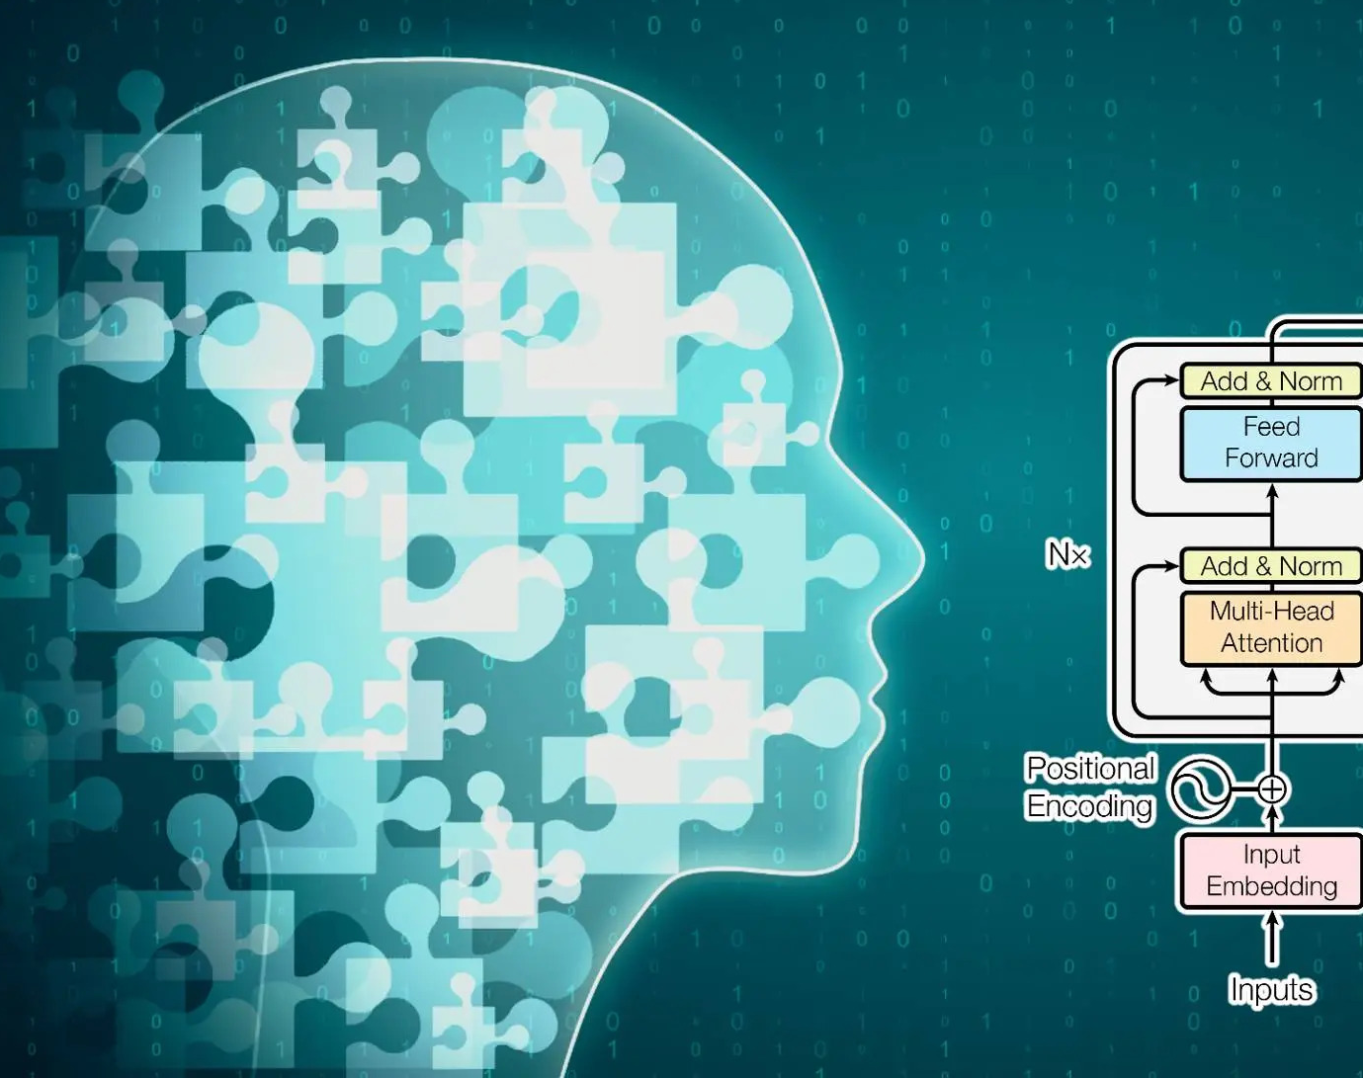
Chapter 1
How does LLM work?

Slide 7
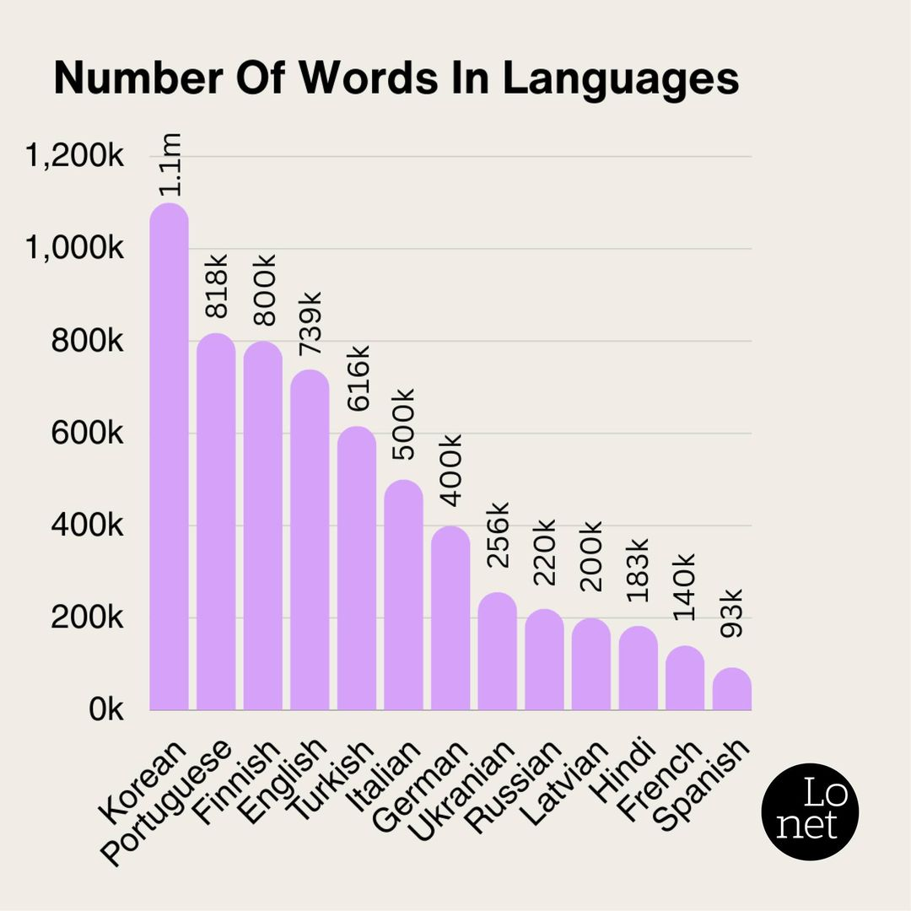
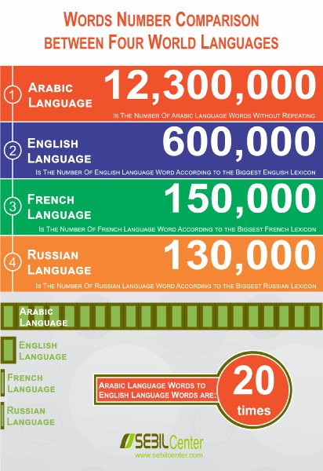

Slide 8
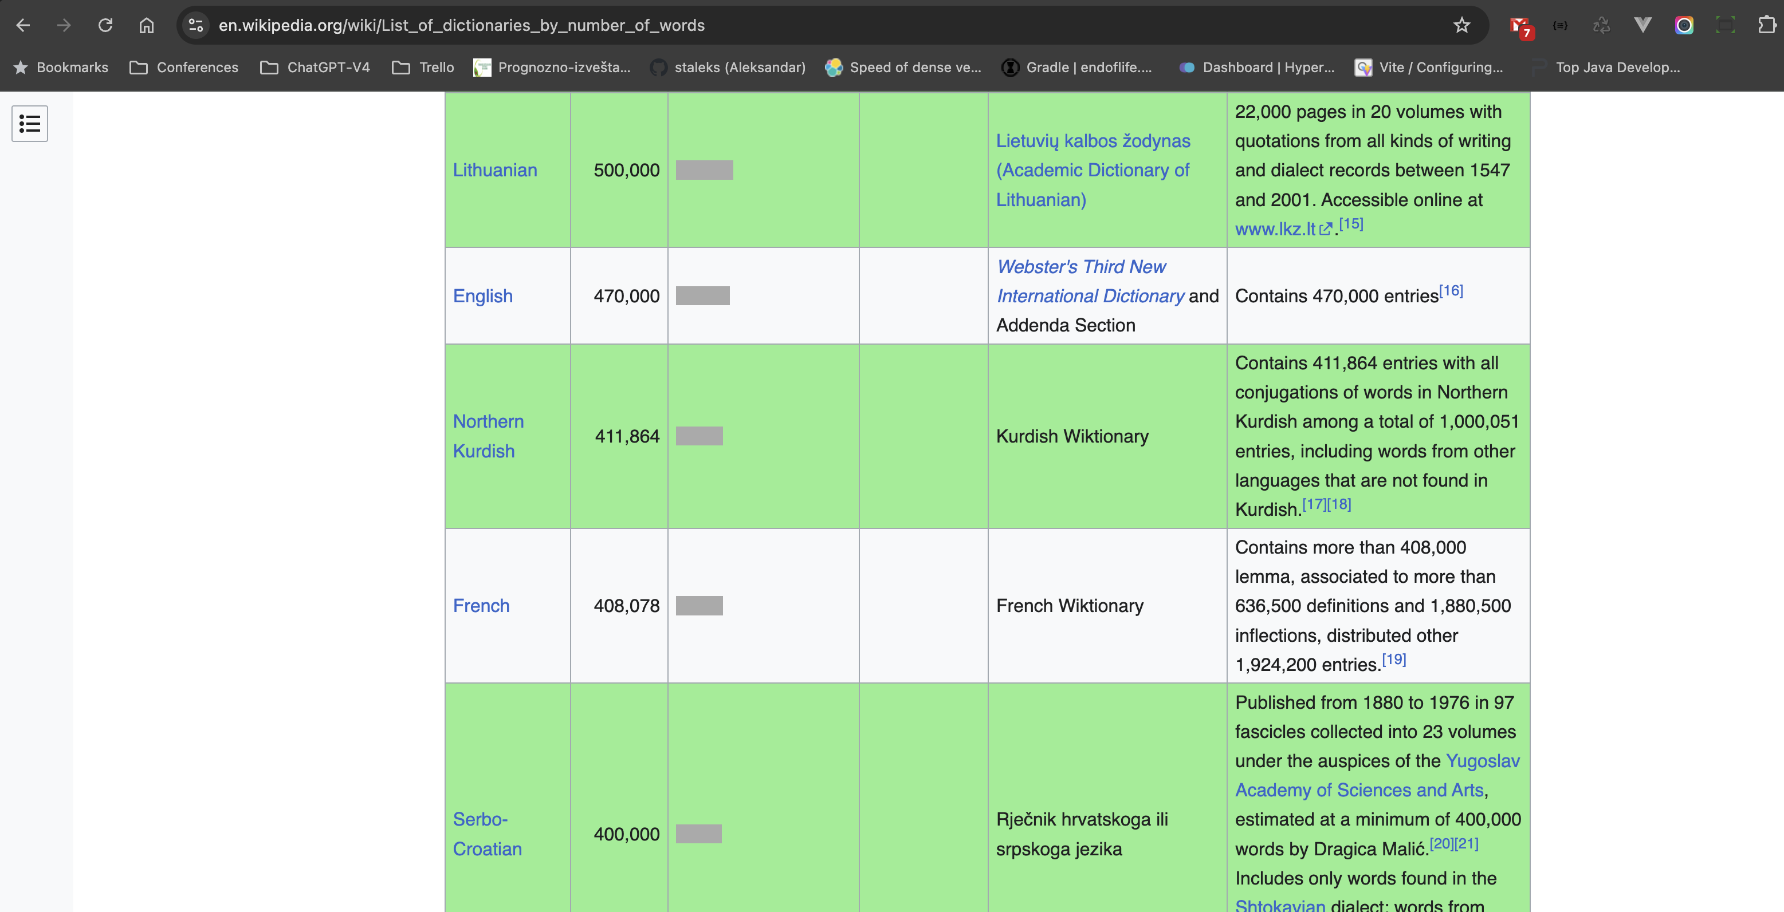

Slide 9
How does LLM work?
1. - Abrakadabra
2. - Agregat
3. - Azija
4. - Aždaja
…
399.999. - Zebra
400.000. - Zima
(engl. Thank You for coming to the presentation.)
Hvala Vam što ste došli na prezentaciju.
5 25 100 43 7 54 72

Slide 10
How does LLM work?
hvala: ti
5%
hvala: vam
5%
hvala: mu
3%
…
hvala: zima
0,001%
Sum (100%)
2-grams

Slide 11
How does LLM work?
hvala vam: puno
10%
hvala vam: na
8%
hvala vam: što
15%
…
hvala vam: zima
0,00001%
(engl. Thank You for coming to the presentation.)
Hvala Vam što ste došli na prezentaciju.
Sum (100%)
3-grams
5 25 100 43 7 54 72

Slide 12

The Transformer
model architecture

Slide 13
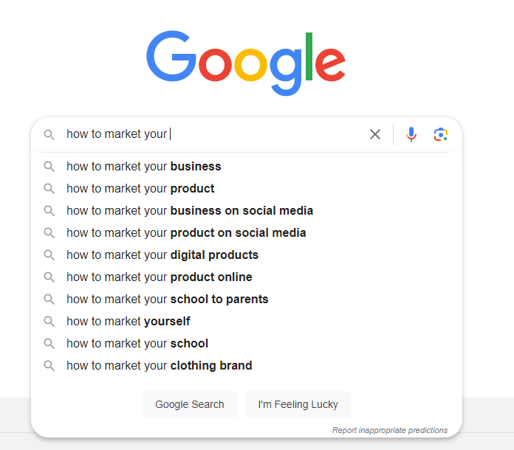
XYZ (Google/Bing etc.) on steroids

Slide 14
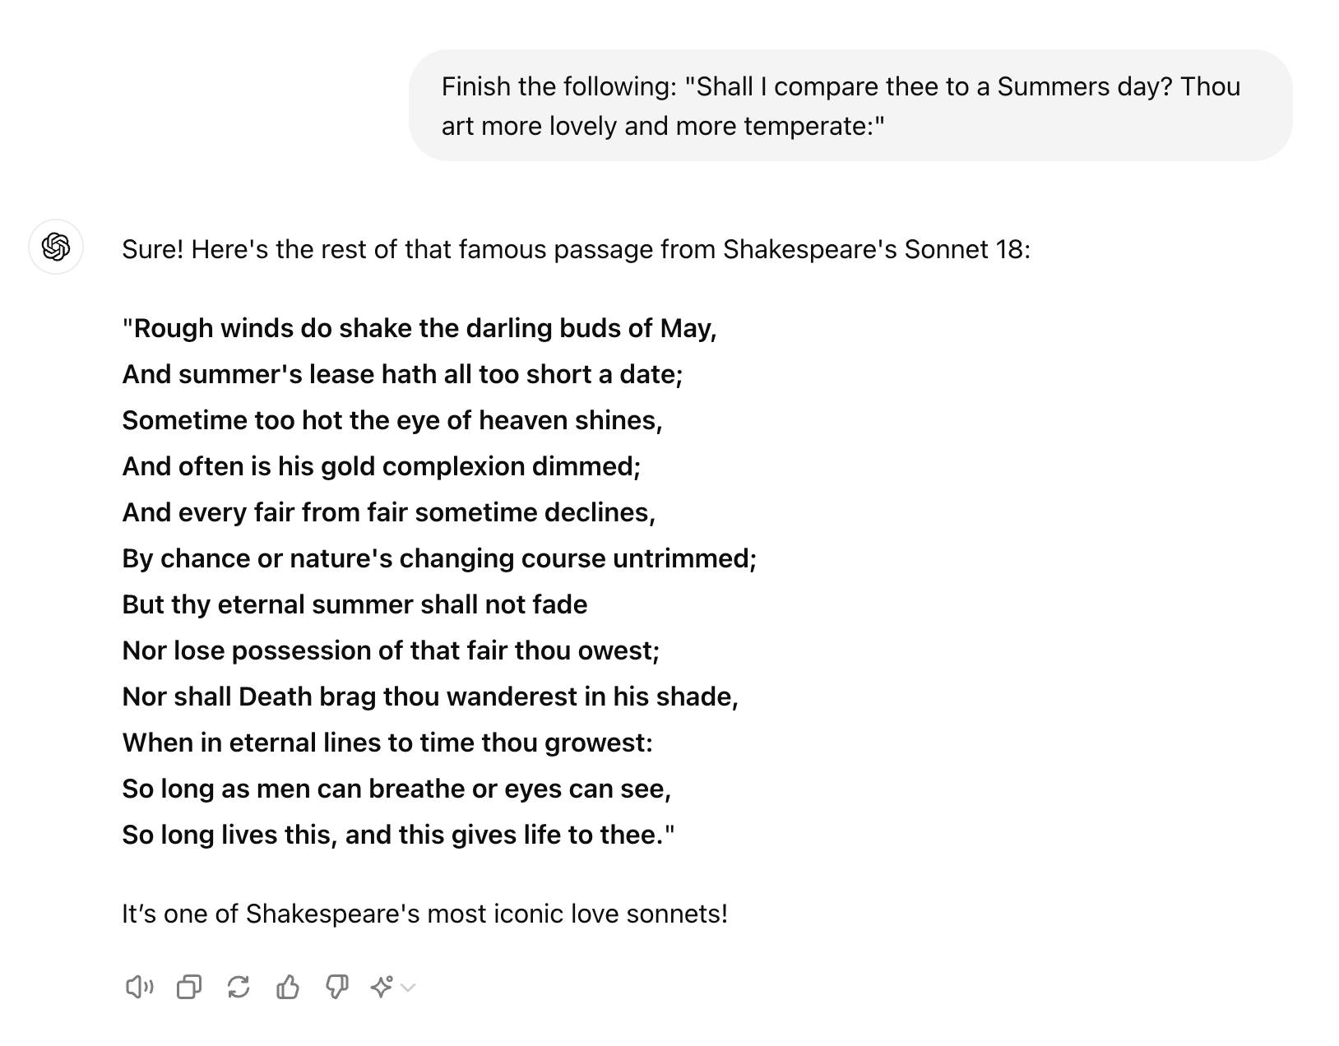
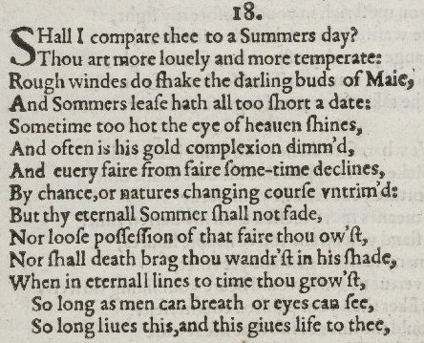
Generating text

Slide 15


How about creativity?

Slide 16

Creativity & temperature
hvala vam: što
15%
most likely
hvala vam: puno
10%
likely
hvala vam: na
8%
hvala vam: zima
0,00001%
(engl. Thank You … )
Hvala Vam …
5 25
Notes:
This process is call “Raising the Temperature”

Slide 17

Unhinged teenager
has a lot of knowledge but needs some steering

Slide 18
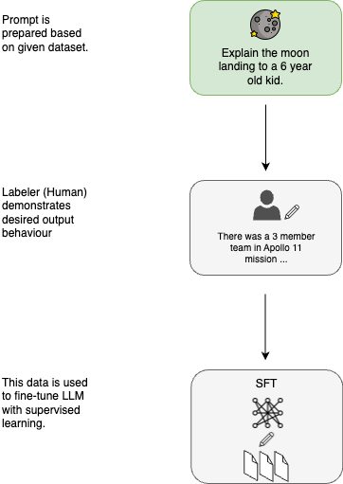
Supervised
Fine Tuning
Notes:
https://cameronrwolfe.substack.com/p/understanding-and-using-supervised

Slide 19
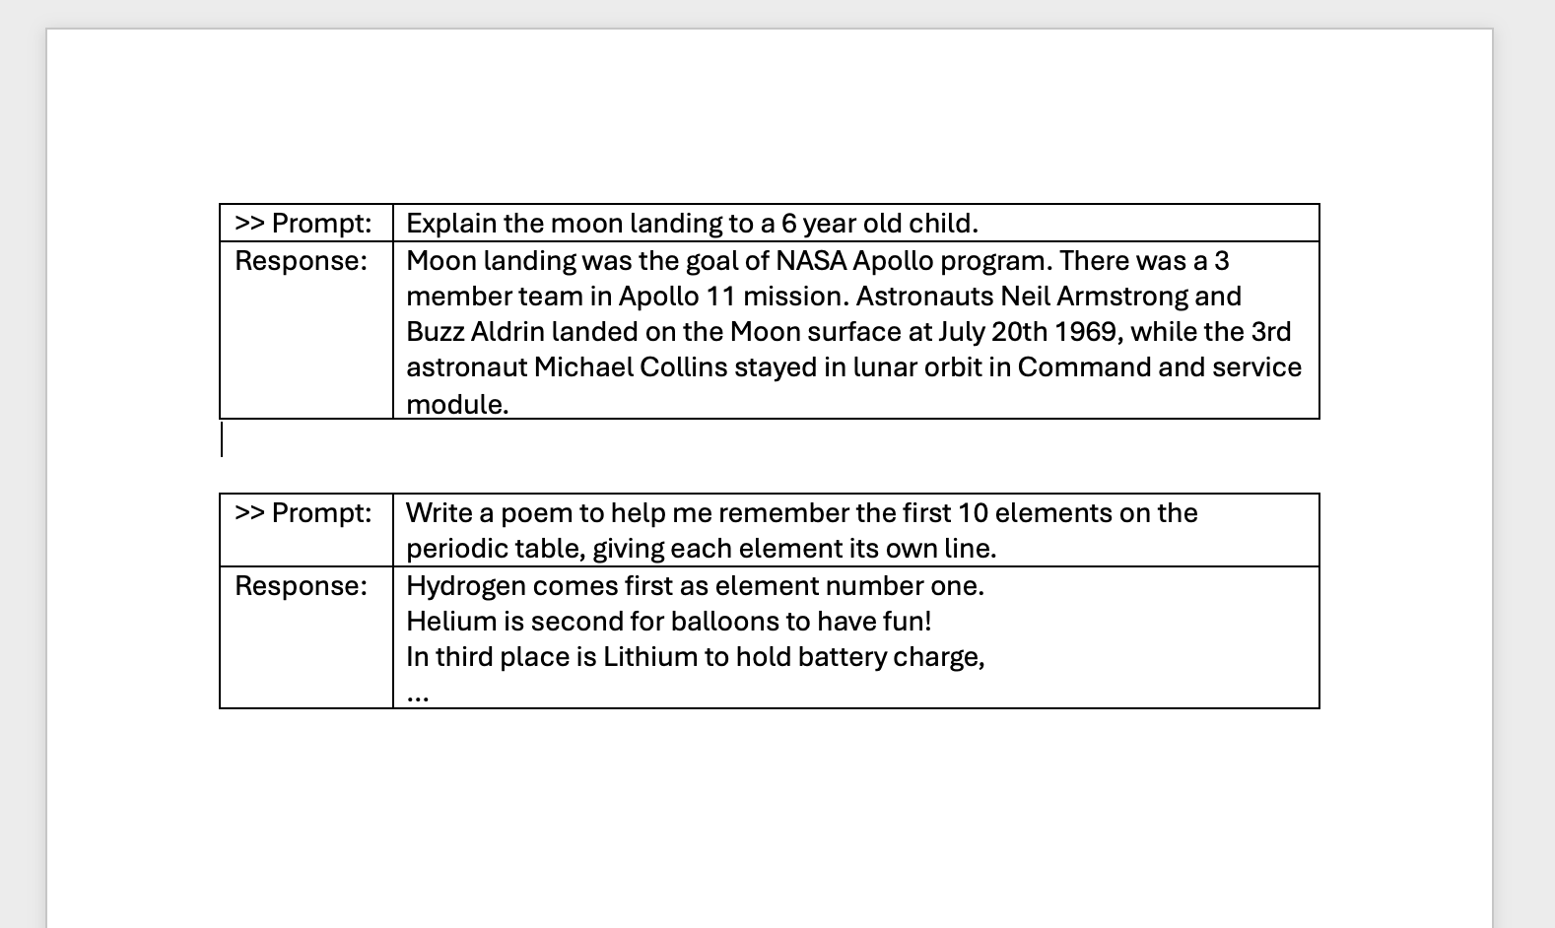
Supervised Fine Tuning
helpfullness

Slide 20
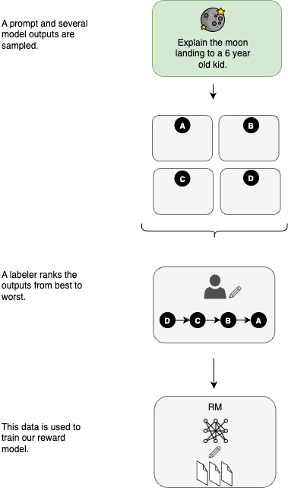
Reinforcement Learning
With Human Intervention

Slide 21


Slide 22

Notes:
“A-HA!” moment – now we know how GPT works.

Slide 23
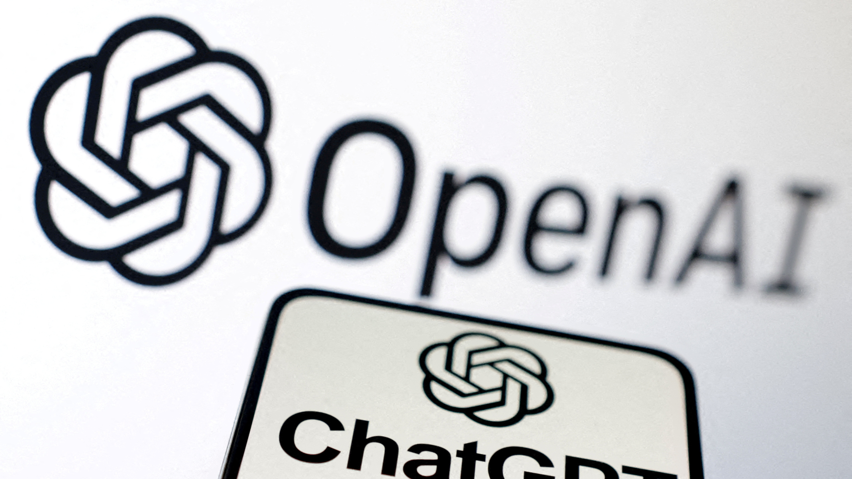
Notes:
“A-HA!” moment – now we know how GPT works.

Slide 24

Notes:
“demo-1” of ChatGPT 3.5-Turbo not knowing who win WorldCup 2022?
“demo-1a” of AnthropicClaudeV2 knows, but doesn’t know UEFA EuroCup 2024?

Slide 25
LLMs limitations
- No updates to the latest information
- Hallucinations
- Updates takes long time
- Domain specific most accurate information

Slide 26

Chapter 2
Retrieval Augmented
Generation

Slide 27
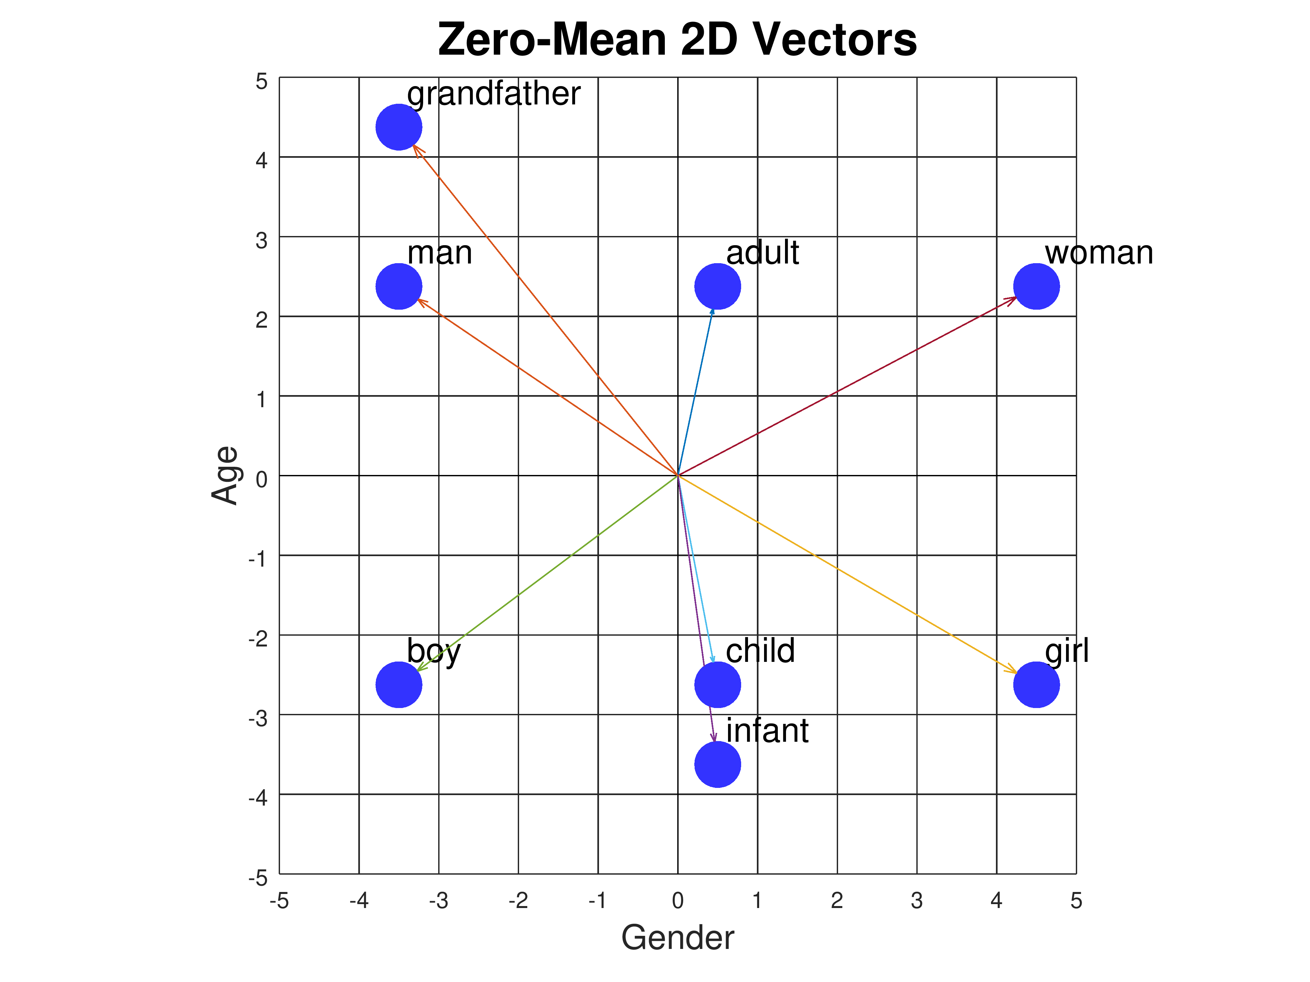
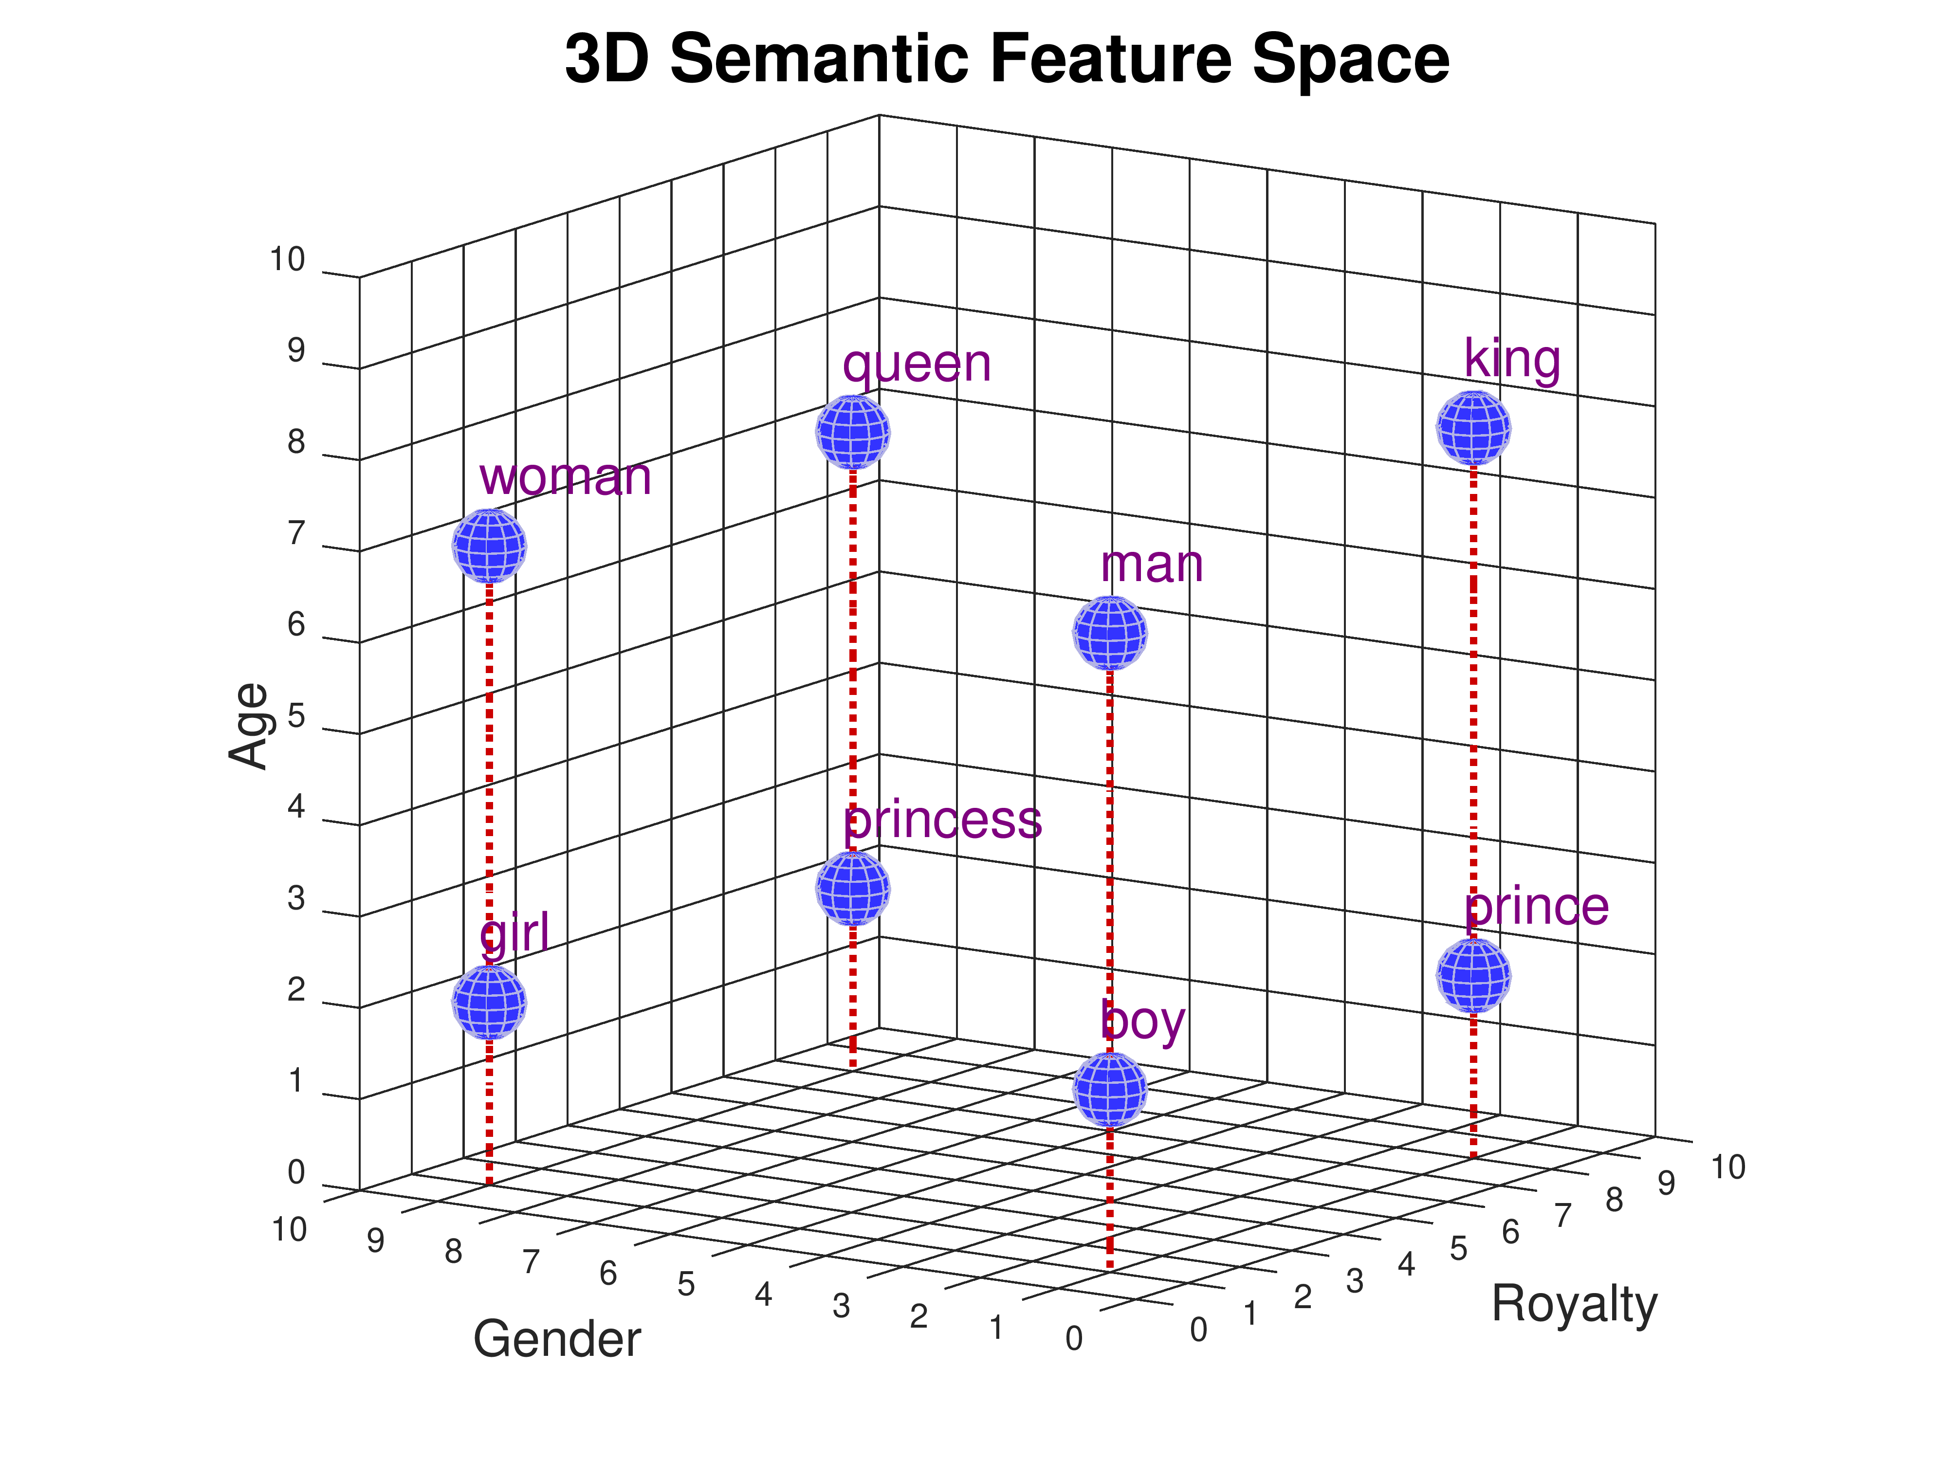
Vectors & embeddings

Slide 28
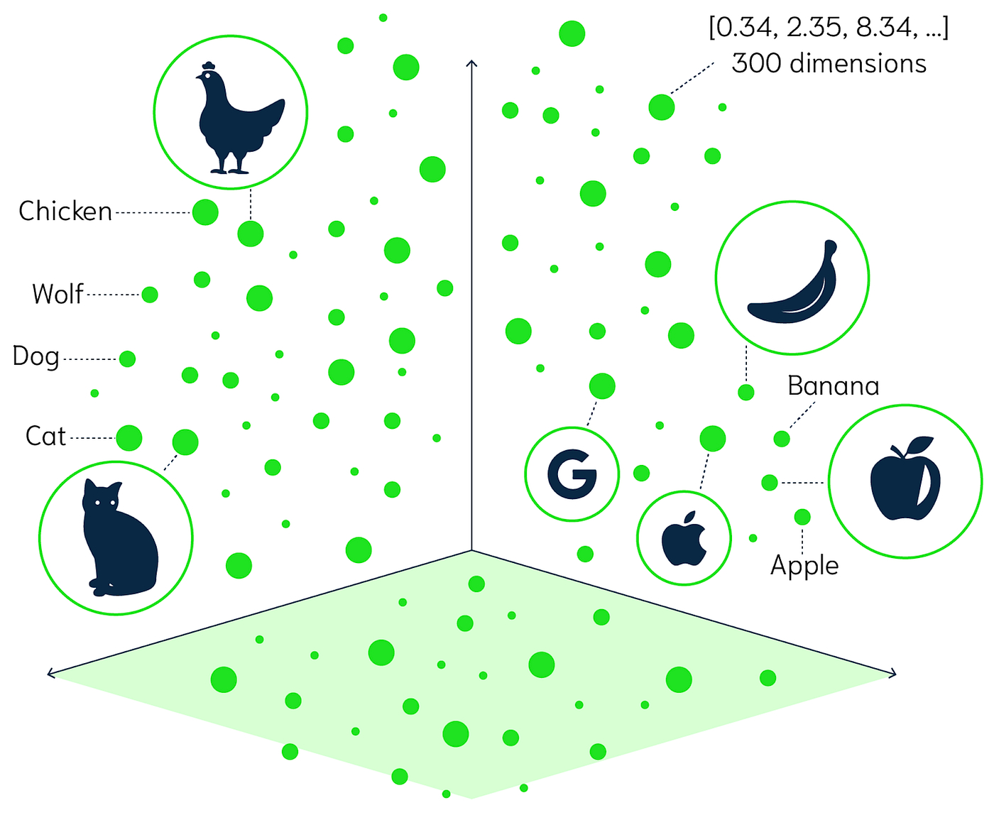

Slide 29
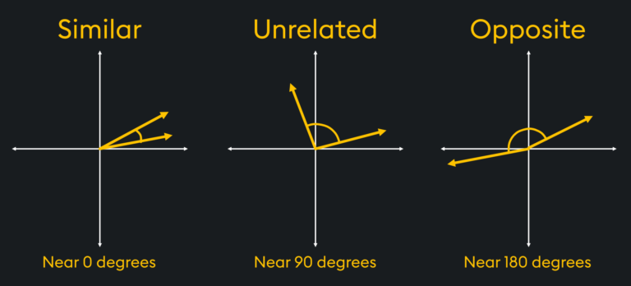

Slide 30
Basic Idea
Use RAG to force the LLMs to work with your data
by injecting it via a vector database

Slide 31

Notes:
Demo-2 – AI Chat with Files

Slide 32
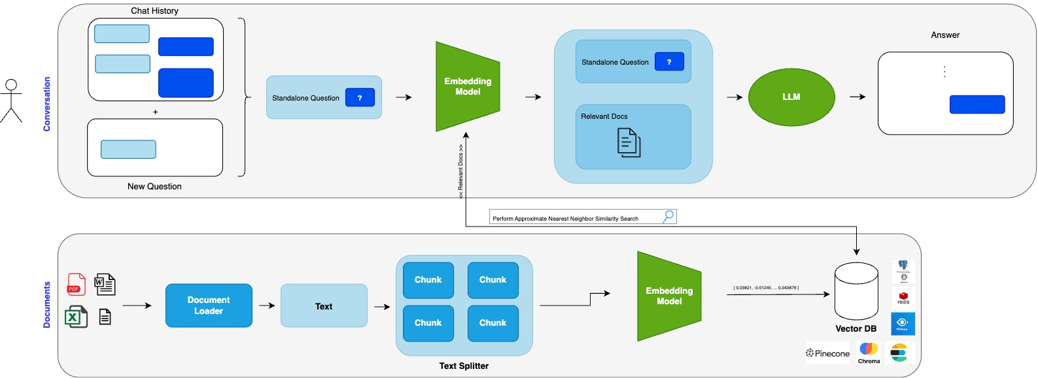
Naive RAG – basic architecture

Slide 33
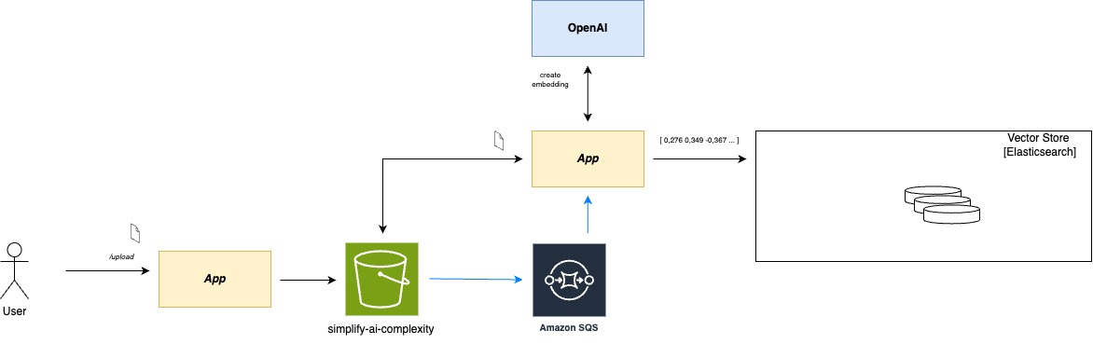

Slide 34
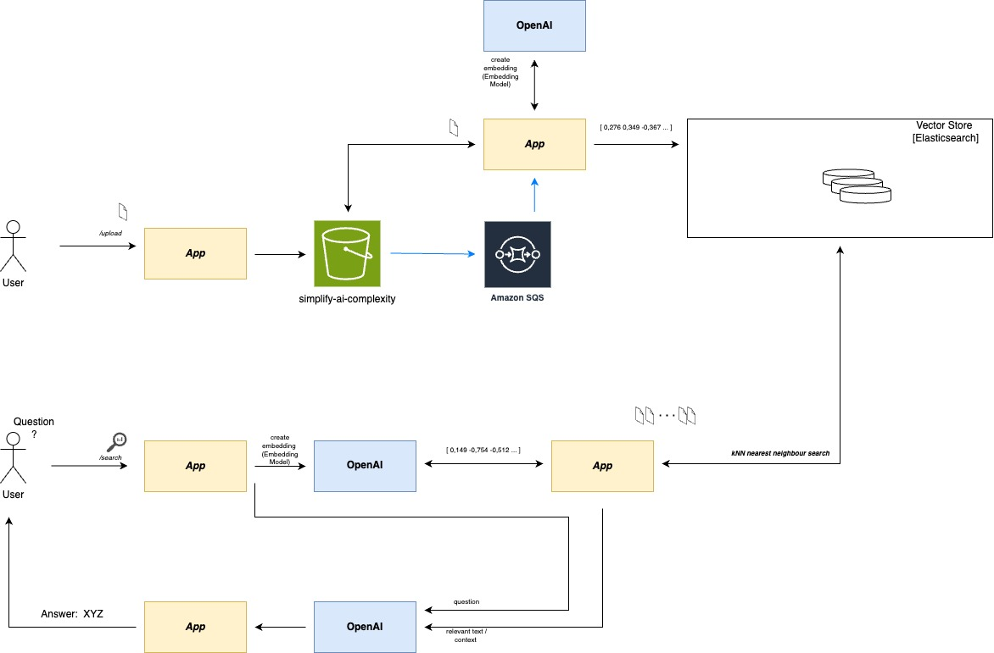

Slide 35
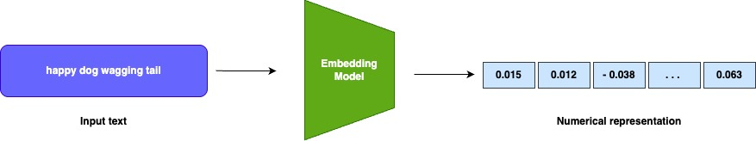
RAG – Embeddings
Embeddings are vectors or arrays of numbers that represent the meaning and context of the tokens. Help models
To understand relation between tokens.
Used to encode input, decode output text and can vary in size/dimension.
Huggingface MTEB leaderboard: https://huggingface.co/spaces/mteb/leaderboard

Slide 36
RAG – Prompt templates
Inputs given to the LLM to generate response or to perform specific task.
The design of these prompts is critical, as it significantly influences the output of the model.
New emerging skill/job – Prompt Engineering

Slide 37

Chapter 3
Langchain4J

Slide 38
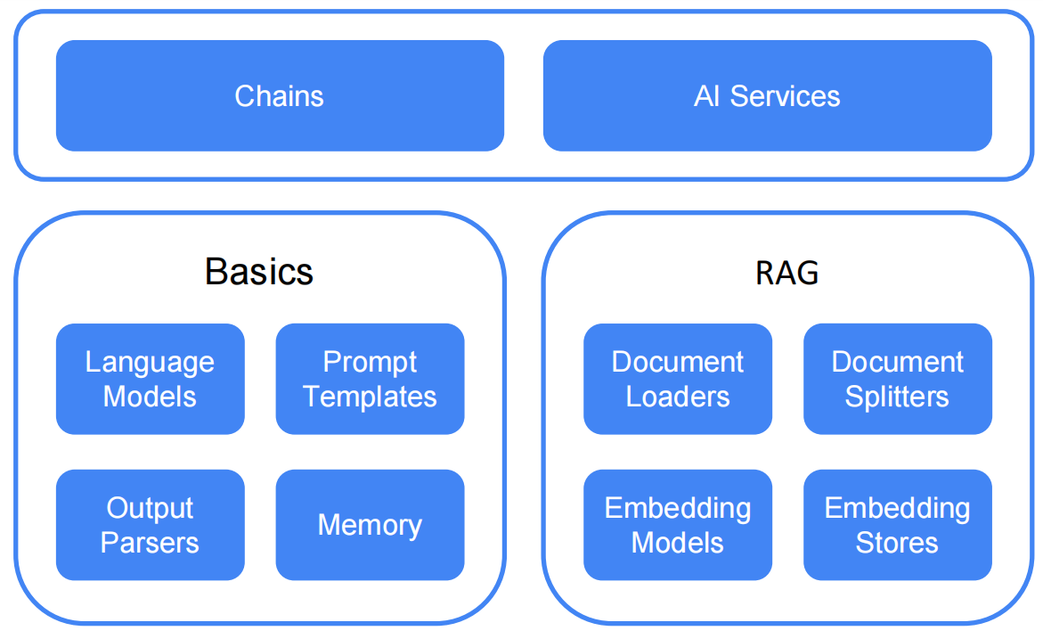
Langchain4J Structure

Slide 39

Unlock the Future V2.0
AI Agents

Slide 40
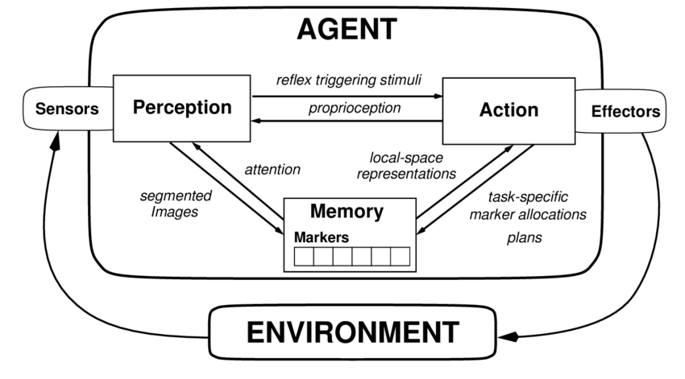
Autonomous AI Agent Architecture
AI Agent is a software program that can interact with its environment, collect data, and use the data to perform self-determined tasks to meet
predetermined goals. Humans set goals, but an AI agent independently chooses the best actions it needs to perform to achieve those goals.

Slide 41
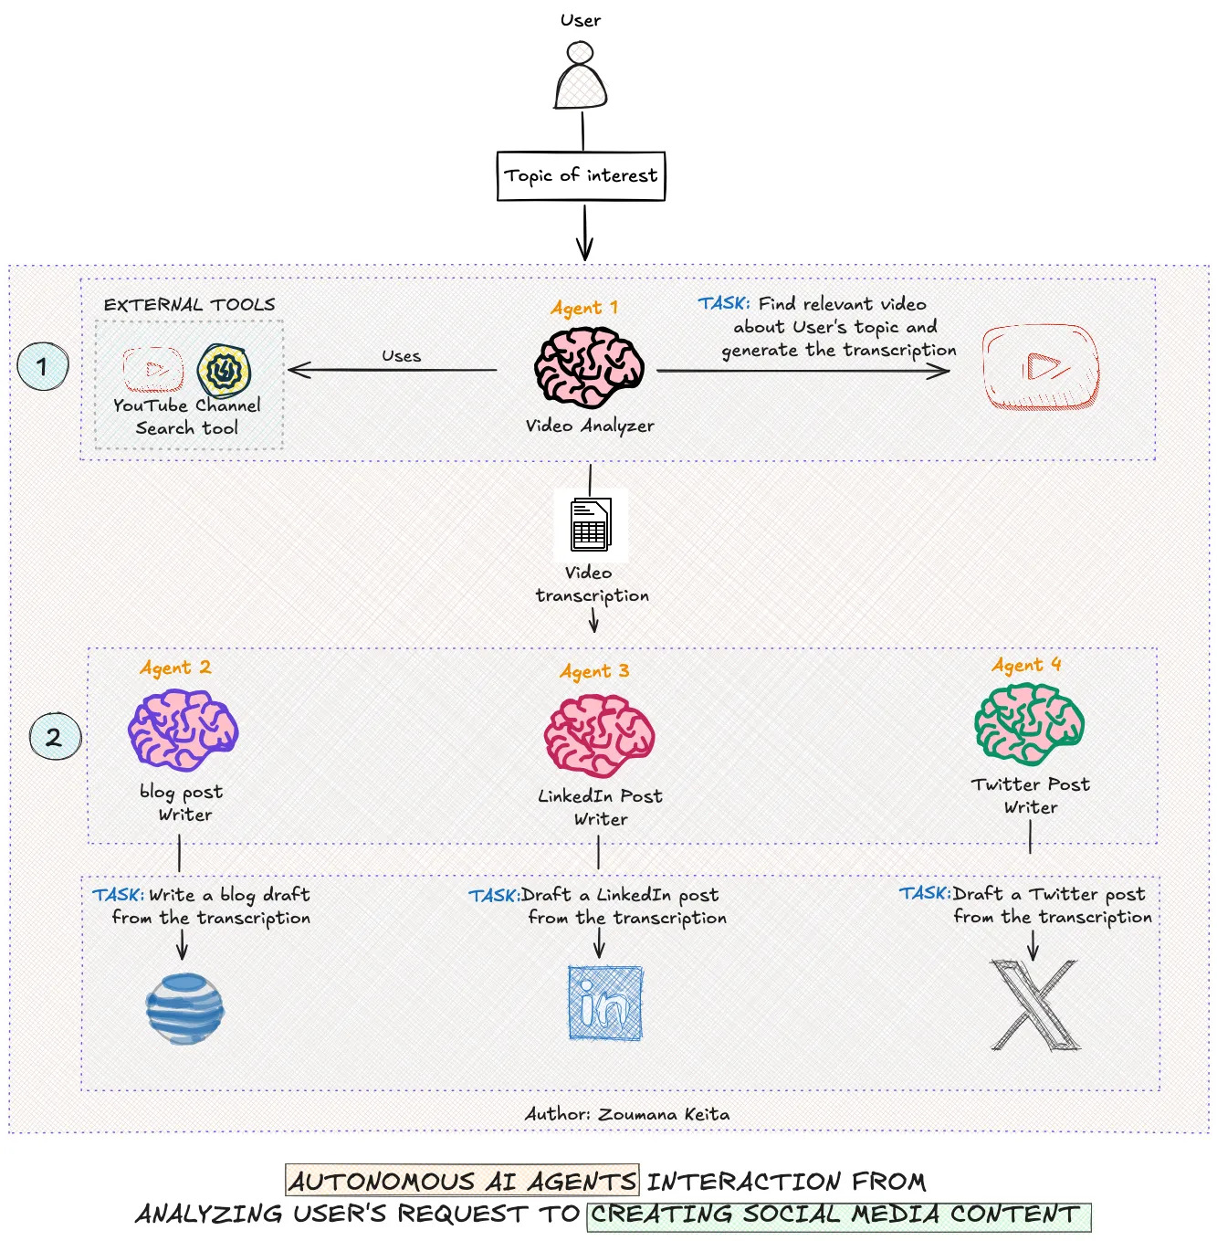
Notes:
- Take web shopping - Imagine an agent who knows my size, preferences, price range, current trends, maybe even what my friends are wearing… - to run through every online shop and find the best winter jacket for me (check out Amazon's Rufus, or Shop.app) .
- Healthcare – first doing audio to text transcription taking notes, other analyze CT image, third analyze blood analyses

Slide 42
Chapter 3
Langchain4J
AI Agent Demo

Slide 43
References
Generative AI
- Andrew Ng - https://www.youtube.com/watch?v=KDBq0GqKpqA
- Mirella Lapata - https://www.youtube.com/watch?v=_6R7Ym6Vy_I
LLM
- Google for developers - https://www.youtube.com/watch?v=iR2O2GPbB0E
- Google Cloud Tech - https://www.youtube.com/watch?v=zizonToFXDs
RAG
- IBM Technology - https://www.youtube.com/watch?v=T-D1OfcDW1M
Langchain4j
- https://docs.langchain4j.dev/
Github - staleks
- https://github.com/staleks/simplifying-ai-complexity

Slide 44


Thank You

Slide 45
Q & A

Slide 46


Slide 47
Thank You

Slide 49


